Slide 1


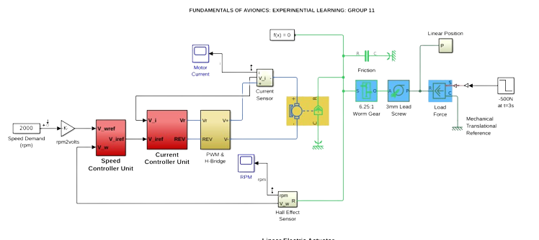
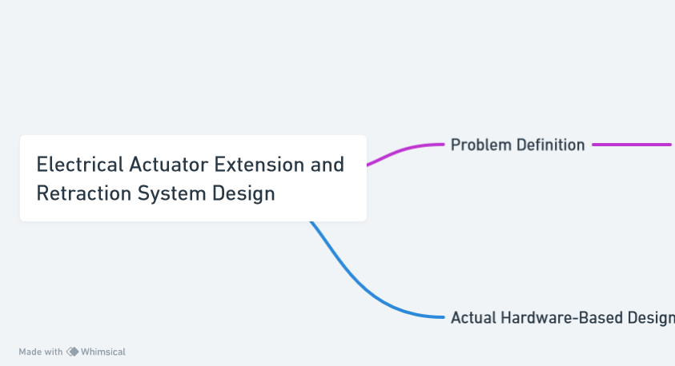

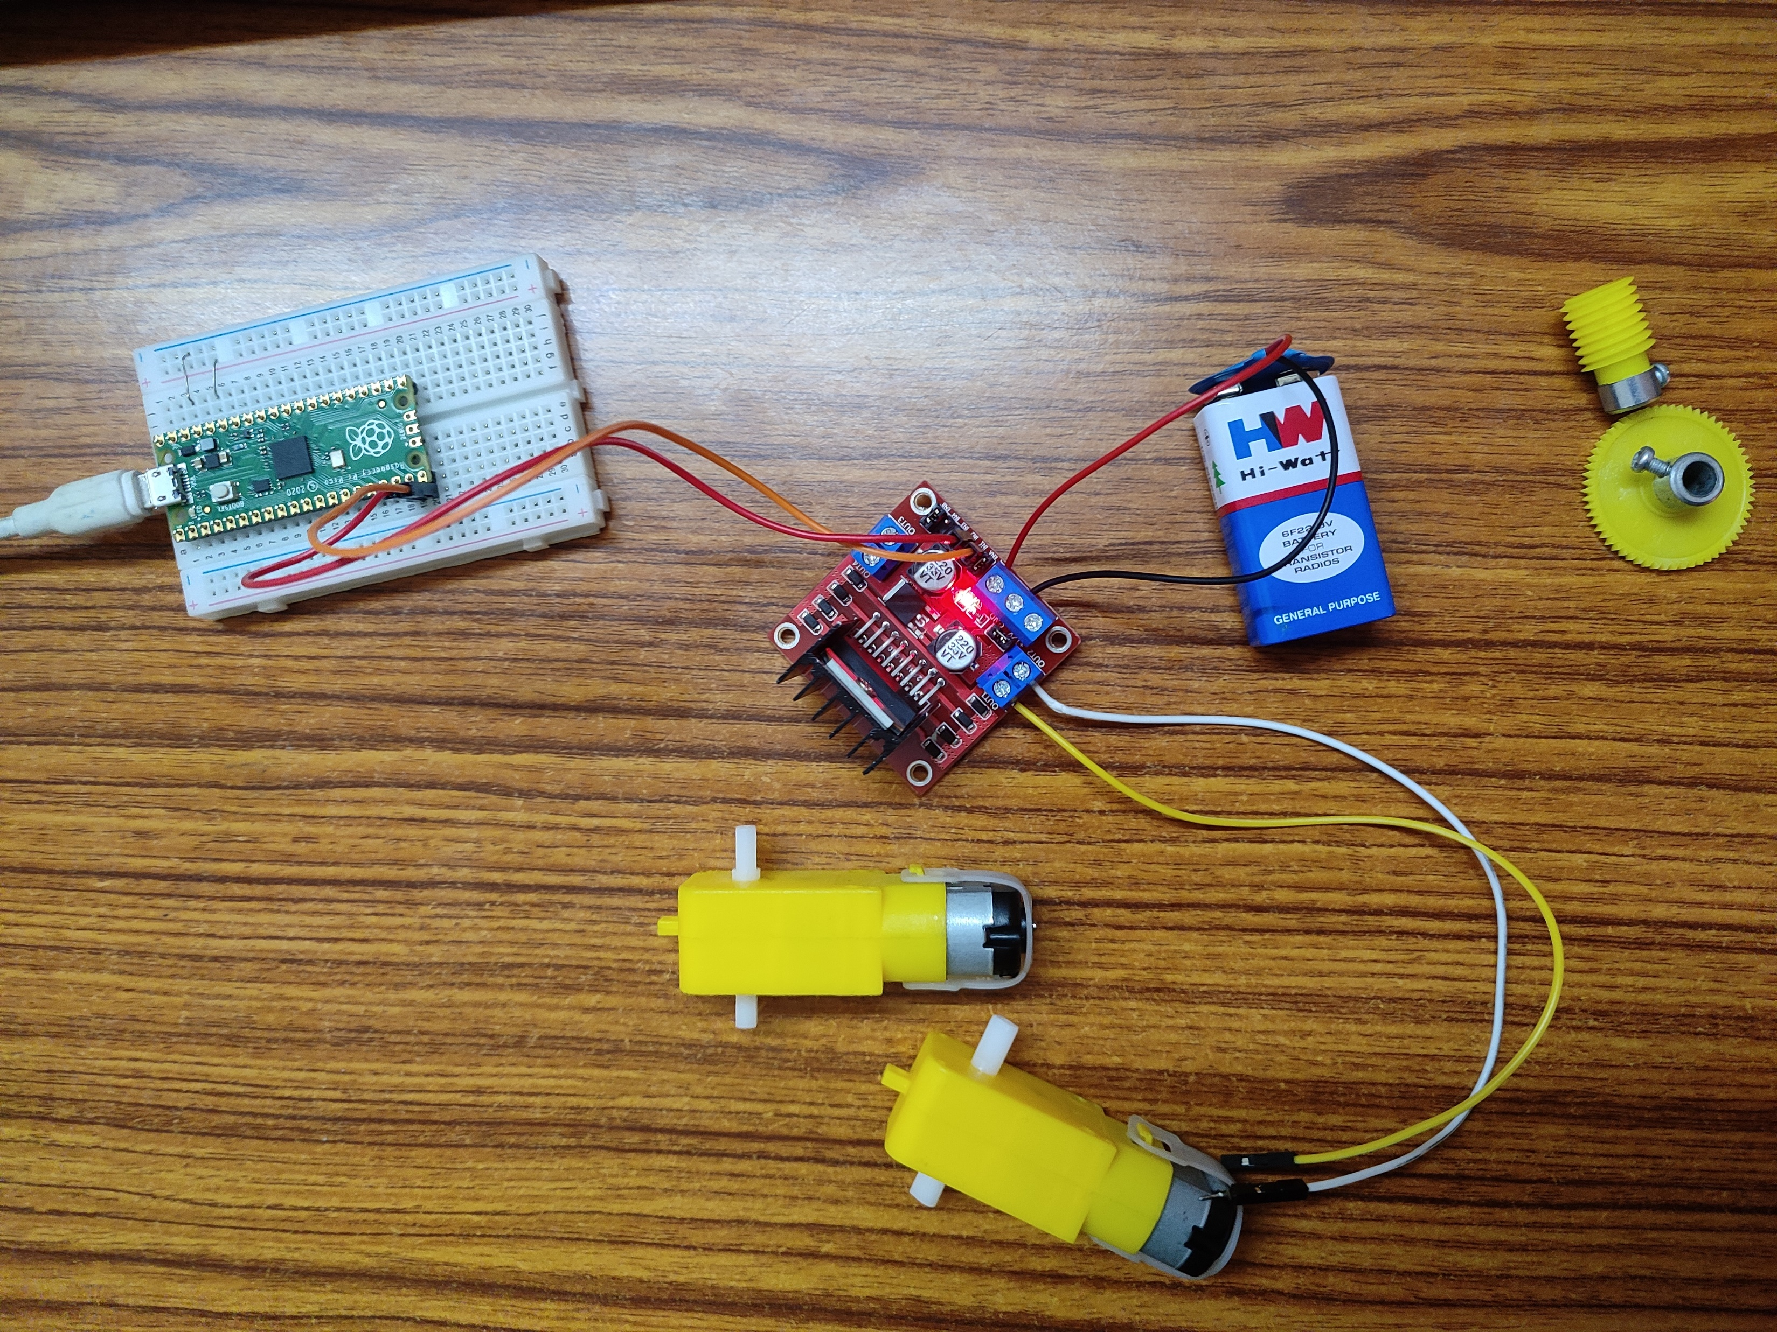
EXPERINENTIAL LEARNING FOR “FUNDAMENTALS OF AVIONICS”
COURSE CODE: 21AS45
GROUP 11
Course Coordinator : Prof. Deepak Bana ( Professor, Department of Aerospace Engineering)
R.V. College of Engineering, Bangalore-59
1) AN OVERVIEW
4) OBJECTIVE
6) SIMULINK MODEL
Experiential Learning Focus:
This initiative centers on hands-on exploration, emphasizing the practical design of an Electrical Actuator Operating System.
Synchronized Actuator Control: The primary goal is to orchestrate the simultaneous linear extension and retraction of two actuators using a microcontroller.-
Microcontroller Selection: A suitable microcontroller is meticulously chosen to serve as the system's central control unit, ensuring precise coordination of actuator movements.
Design and implement a synchronized Electrical Actuator Operating System for controlling two actuators with precision.
Utilize a microcontroller to orchestrate the extension (15 cm) and retraction (10 cm) of the actuators within a total 15 cm extension range.
Develop a comprehensive Simulink MATLAB model to simulate and analyze the behavior of the actuator system, facilitating refinement and optimization
2) TOOLS AND TECHNOLOGIES USED IN INDUSTRIES
5) METHODOLOGY (FLOW CHART/PSEUDO CODE)
.
Table: SOFTWARE USED
7) CONCLUSION
TEAM MEMBERS
SOFTWARE COMPONNTS | SPECIFICATIONS
SIMULINK | Utilized for dynamic system modeling, simulation, and analysis, Simulink aided in the design and validation of the linear electric actuator system
THONNY | Served as the Integrated Development Environment (IDE) for writing and testing Python scripts, essential for controlling the Raspberry Pi Pico microcontroller.
SOLIDWORKS | Employed for the creation of detailed 3D models, SolidWorks facilitated the mechanical aspects of the actuator system.
GITHUB | Used for version control and collaborative development
Effective Team Collaboration: Seamless teamwork was fundamental to the project's success.-
Diverse Contributions: Suhana excelled in algorithm development and microcontroller programming, Sadiq led in system design and MATLAB simulation, while Veerbhadrayya expertly handled hardware selection and analysis.-
Holistic Learning: This experiential approach integrated theory with hands-on practice, providing a comprehensive understanding of Electrical Actuator.
SUHANA ARSH (USN: 1RV22AS405): Algorithm development and microcontroller programming.
SADIQ ALI MIR (USN: 1RV21AS049): System design and simulation in MATLAB Simulink.
VEERABHADRAYYA C ROOGI (1RV21AS063):
Hardware selection and analysis.
UNDER THE GUIDANCE OF
PROFESSOR DEEPAK BANA
DEPARTMENT OF AEROSAPCE ENGINEEING, RV COLLEGE OF ENGINEERING
GitHub Link: https://github.com/sadiqalimir/actuatorOS
3) PROBLEM STATEMENT
6) HARDWARE MODEL
9) TAKE AWAY
The experiential learning aims to develop an Electrical Actuator Operating System capable of synchronizing the linear extension and retraction of two actuators using a microcontroller. The system must facilitate precise control, ensuring an extension of 15 cm and retraction of 10 cm out of the total 15 cm extension length. Additionally, a Simulink MATLAB model will be created to simulate the behavior of the actuator system, providing a comprehensive understanding of its functionality for further analysis and optimization.
Hardware model contains Raspberry Pi Pico, Breadboard, L298 Motor Driver, 9V Battery, DC Motors, USB Cable Type B
Hands-on Experience: Gain practical insights into designing an Electrical Actuator Operating System, covering microcontroller selection and component integration.
Synchronized Control: Understand the crucial coordination required between two actuators for optimal performance, emphasizing the importance of control algorithms.-
Component Integration: Learn the significance of understanding technical parameters and practical availability of components for seamless system functionality

